Slide 1
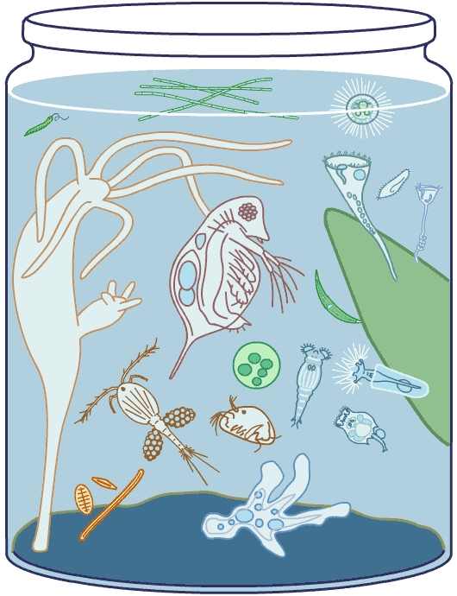
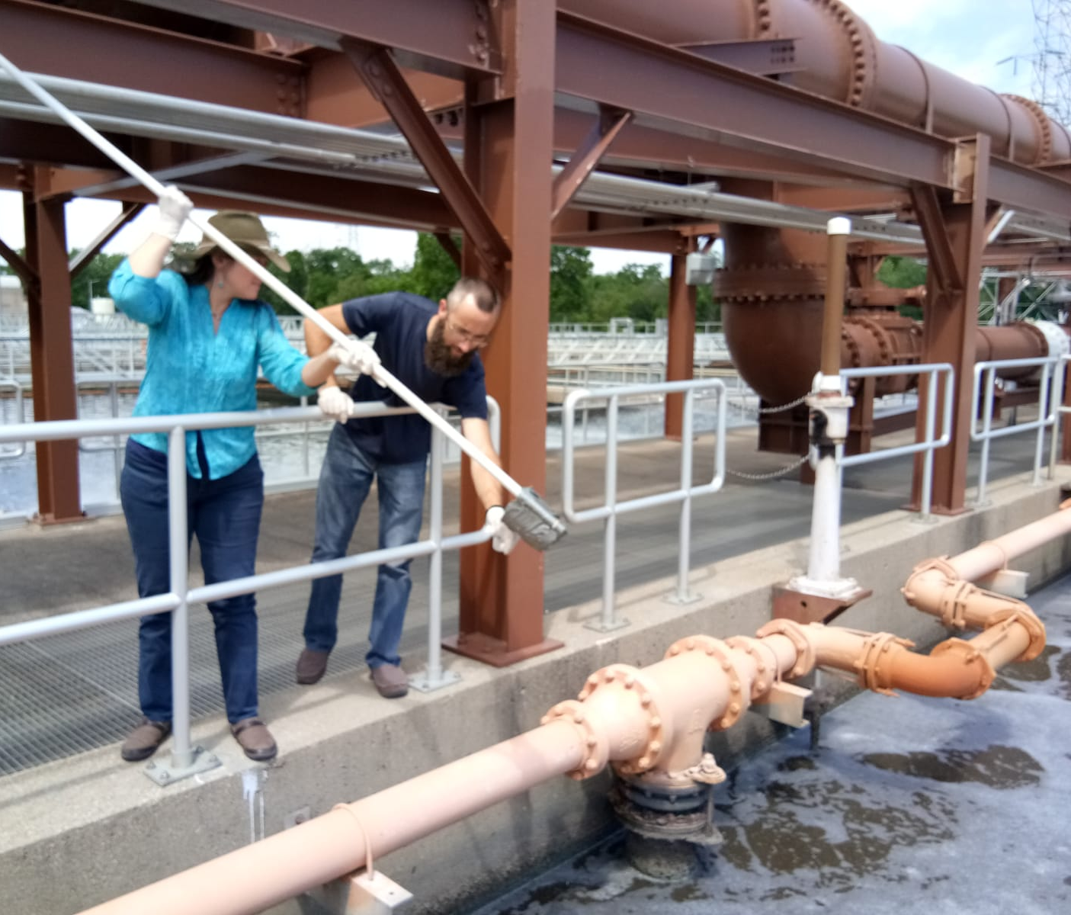
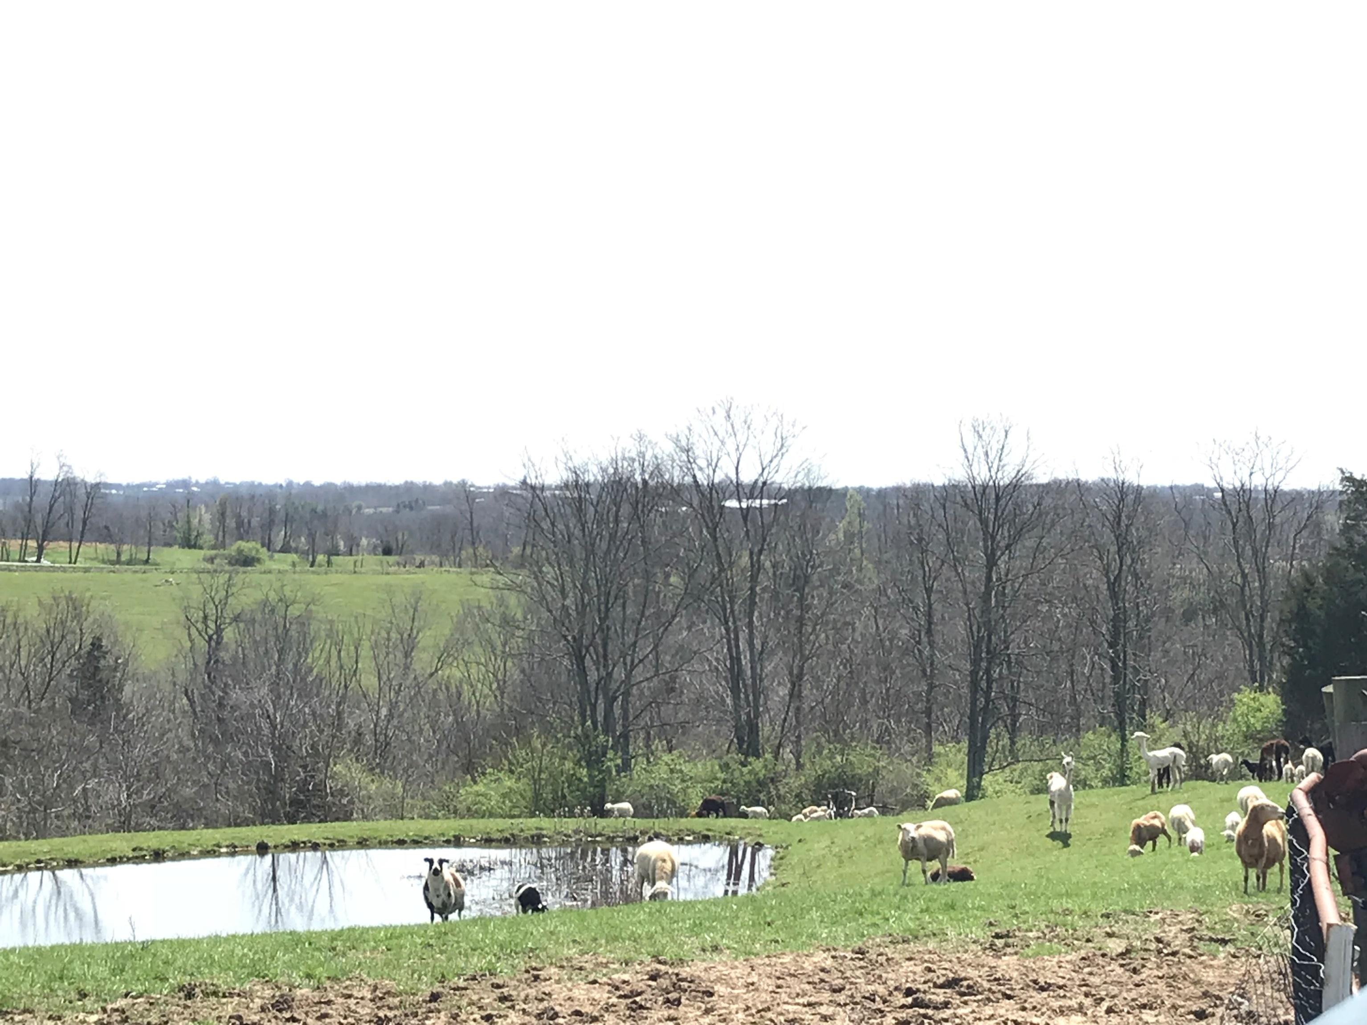
What’s in the Water? Jennifer Leigh Myka ; Majors Biology Gateway Community & Technical College
RET is funded by the National Science Foundation, grant # EEC-1710826
Summer Research: Where is Phosphorus Removed from Wastewater in a Local Wastewater Treatment Plant?
From Research to Classroom:
How Do We Engineer a Solution?
What Do We Need to Know?
The Big Idea
Identify/Define the Problem
Phosphorus (P) is a water pollutant.
Gather Information & Identify Alternatives
Plot P removal in a local wastewater treatment plant.
Conclusions: Will a proposed membrane bioreactor installation increase phosphorus removal?
Challenge Based Learning
Identify the Big Idea
Develop the Essential Question
Develop the Challenge
Develop Guiding Questions
Identify Societal Impacts
How Do We Answer Questions?
Every living organism requires water for life.
Pondwacourtesy of: http://www.microscopy-uk.org.uk/index-no-ads.html?http://www.microscopy-uk.org.uk/ponddip/ter organisms image
Engineering Design Process
Identify & Define Problem
Gather Information
Identify Alternatives & Select Solution
Implement Solution
Evaluate Solution
Reflect & Refine

